Slide 1
FinTech Project 2
Predicting Diamond Prices
Mayura Solow
Nico Eiden
KaBria Broadwater
Dan Watson

Slide 2
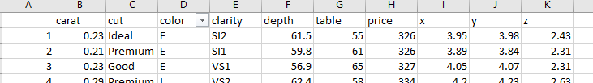

Diamond Price Prediction Data
The data was obtained from Diamonds Prices | Kaggle
The data has nearly 53,940 records
Data includes
caret -size
cut - shape of the stone
color - Grades between D and Z and D has the highest values
table - refracts rays of light as they pass
X,Y,Z - three spatial dimensions. X,Y, Z coordinates. These denote height, width and depth
Clarity - grade on a scale from Flawless to Included

Slide 3
Logistic Regression Model
Logistic Regression uses supervised learning and trains labeled datasets to make predictions
The model considers past factors, known outcomes and predicts the future outcome
Logistic regression is the starting point for all our project and using regression to analyze and predict numerical data

Slide 4
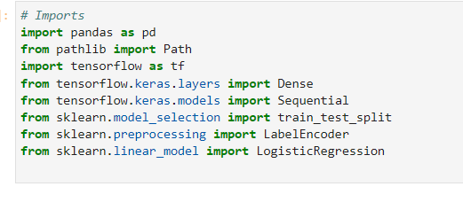
Logistic Regression Model
CSV file with over 53,000 records were read into a Pandas dataframe
Cleaned up the string data with labels
Targeting to predict pricing data and therefore Target and Features were separated
The data was split into to Training and Testing and stored in variables
The results were fitted into logistic regression model
At the end the accuracy was calculated and printed

Slide 5
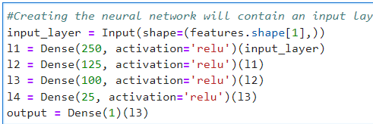
Neural Network Model
The Neural Network contains an input layer, four hidden layers and one output layer. The hidden layers will be densely connected
The first layer contains 250 neurons, the second hidden layer contains 125 neurons, the third hidden layer contains 100 and the fourth contain 25 neurons
Any more than 4 layers and the accuracy suffered.

Slide 6
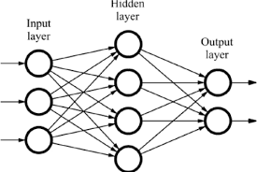
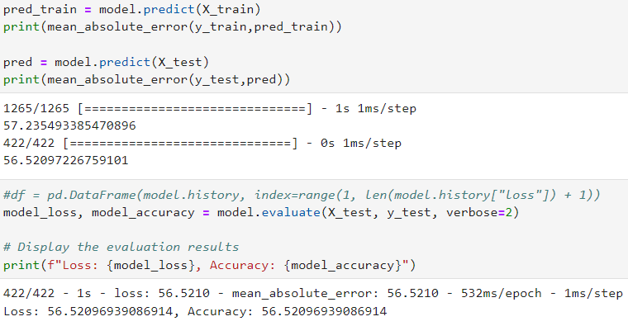
Neural Network Model Cont.
Results:
They varied widely as the neurons were updated.
Highest accuracy reached: 67.2%
Lowest 9%

Slide 7
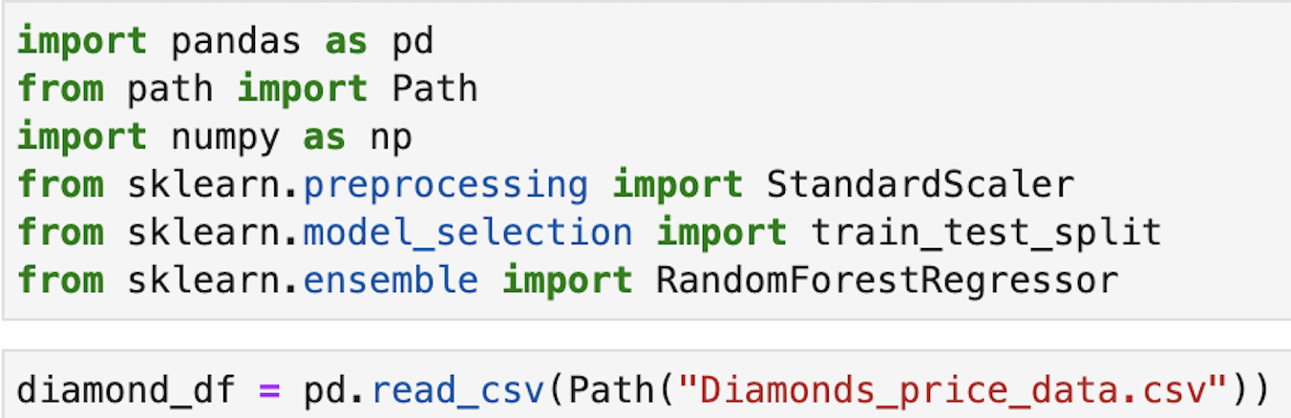
Random Forest Model

Slide 8
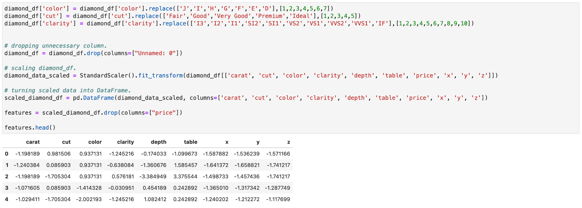
Random Forest (cont.)

Slide 9
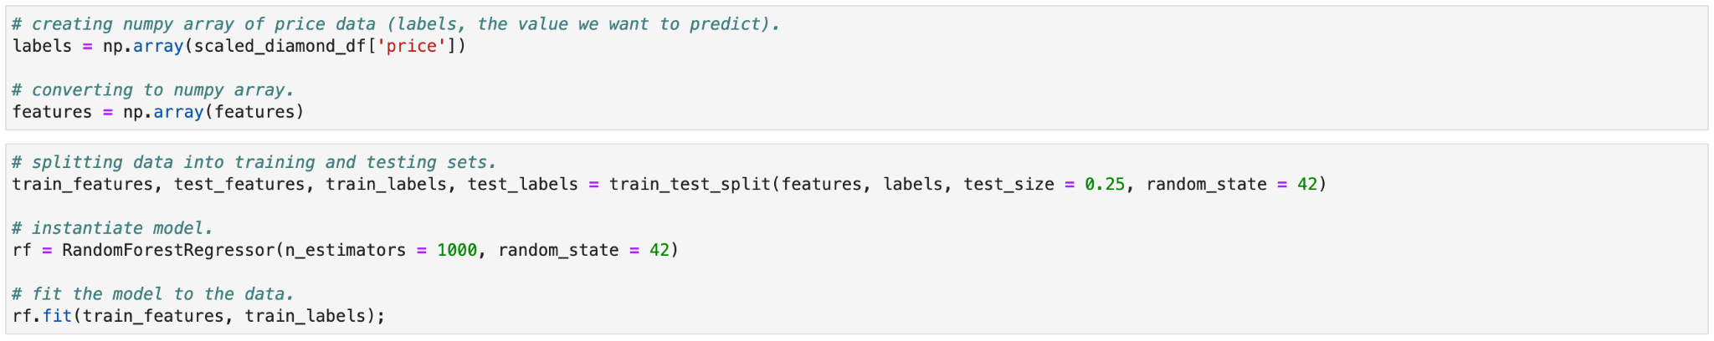
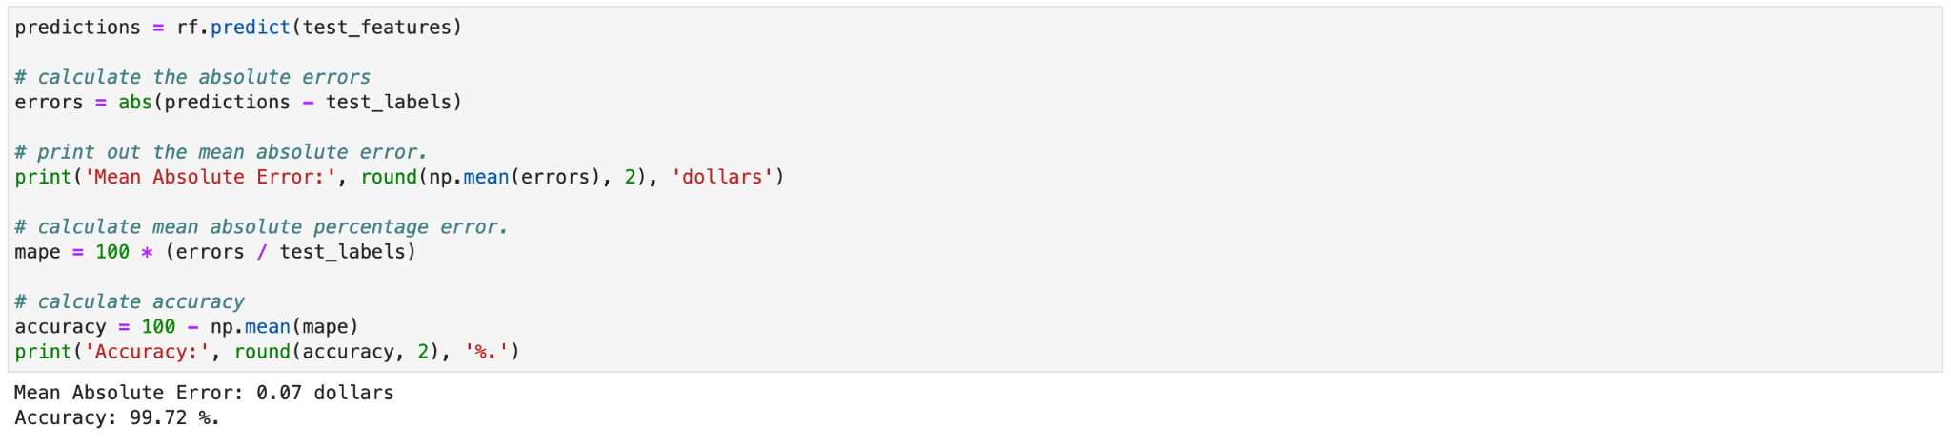
Random Forest (cont.)

Slide 10
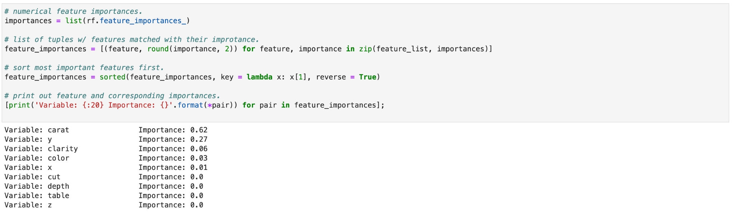
Random Forest (cont.)

Slide 11

Robo Advisor
Conversational User interfaces (CUIs)
Following AWS services were utilized to develop the Robo Advisor to predict diamond prices
Amazon SageMaker
Amazon Lex
Amazon S3
AWS Lambda

Slide 12
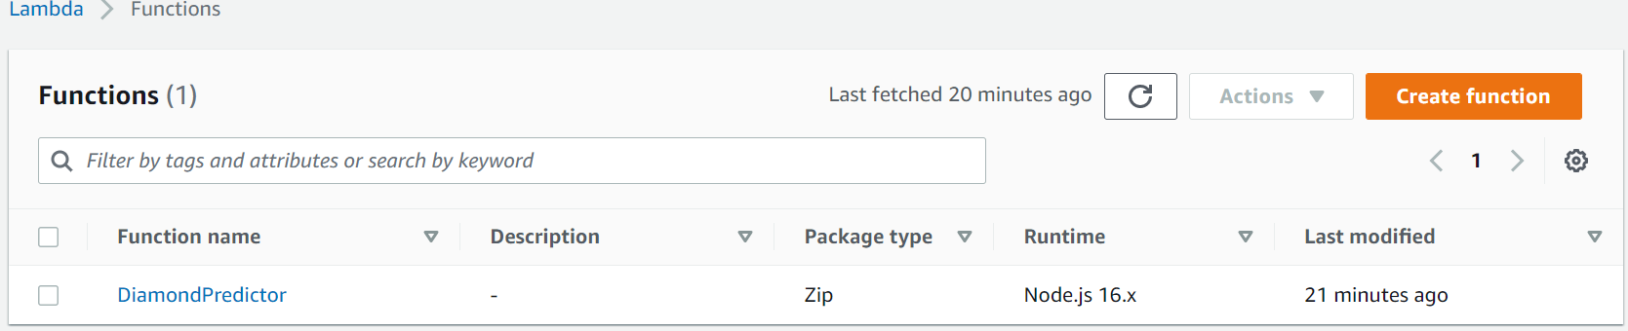
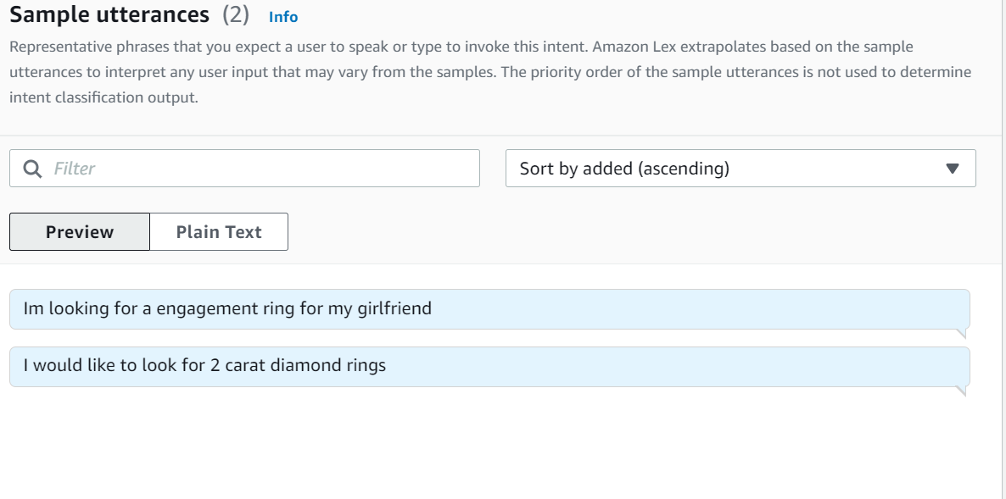
Diamond Price Predictor Lambda Function
&
Utterances
Lambda_function.py

Slide 13
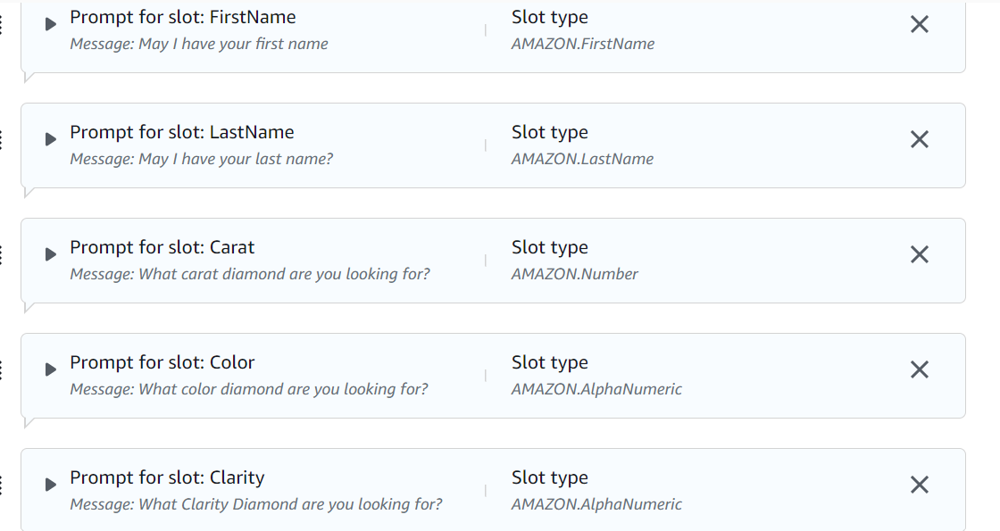
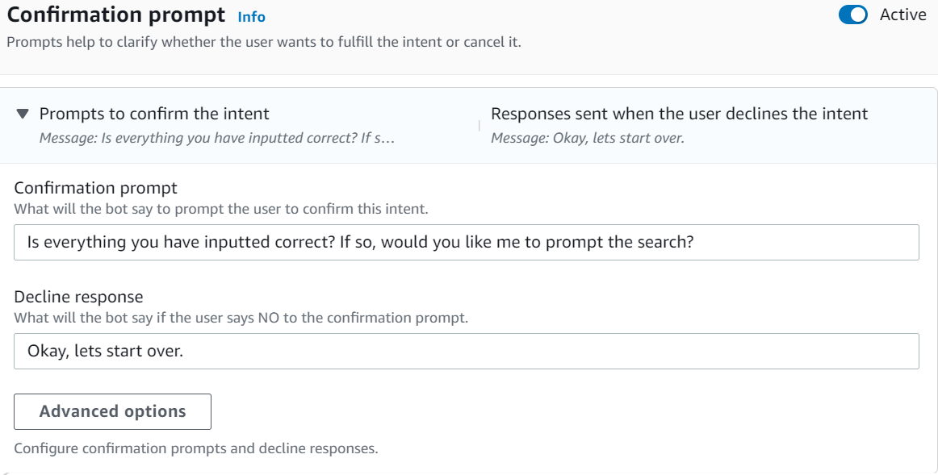
Diamond Price Predictor Advisor
*Slots
*Confirmation Prompt

Slide 14
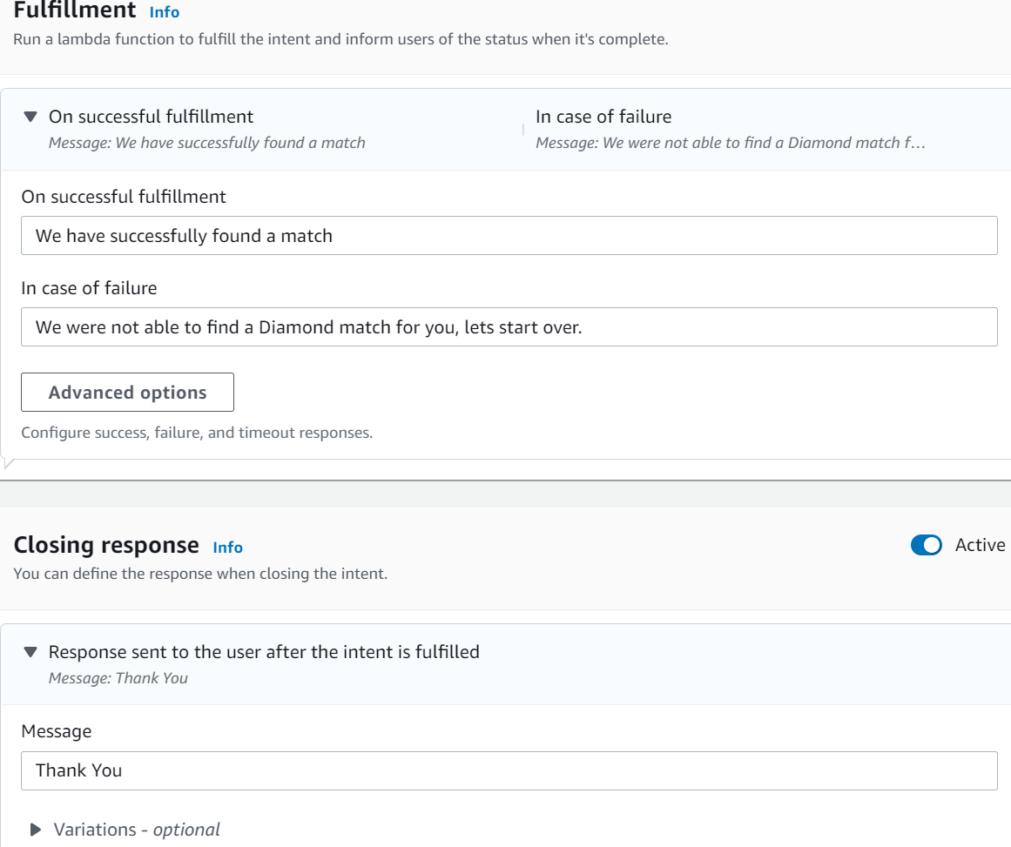
Diamond Predictor
*Fullfillment
*Closing Response

Slide 15
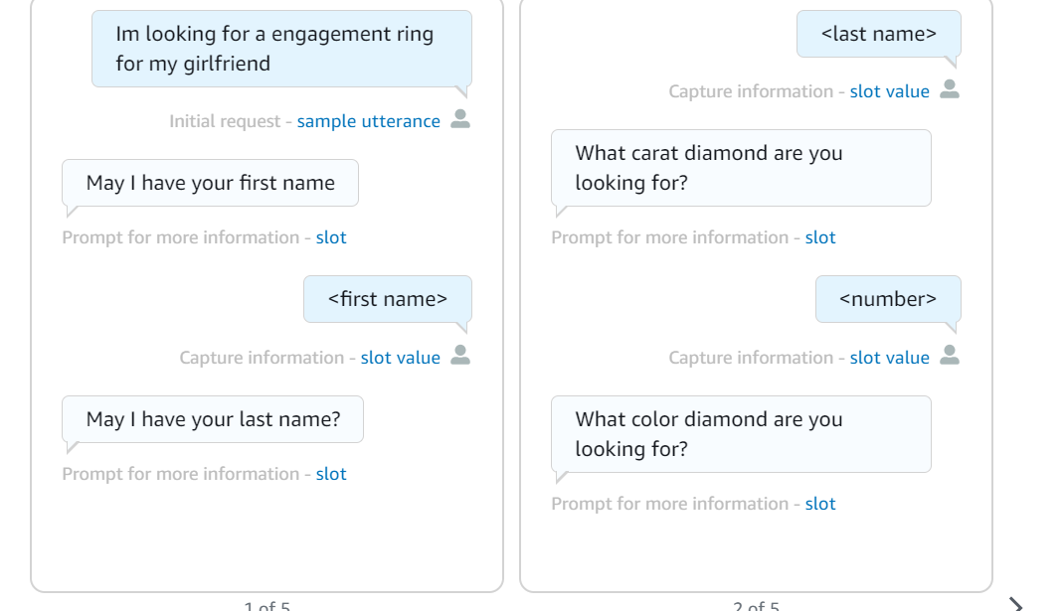
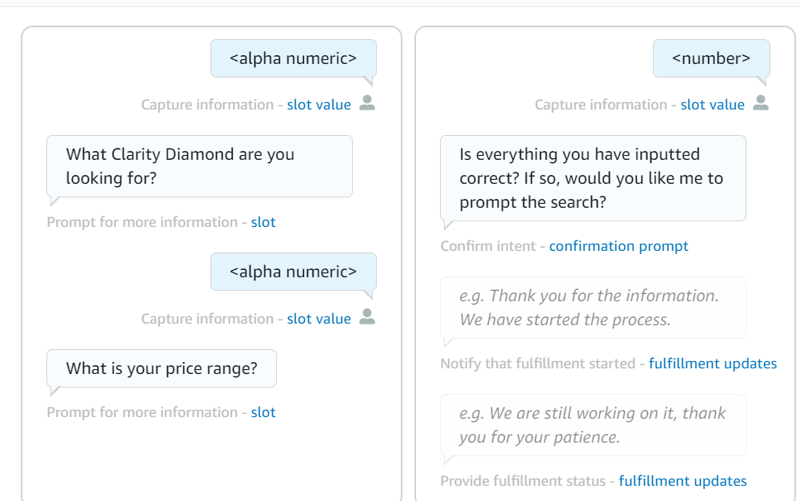
Diamond Price Predictor Advisor

Slide 16
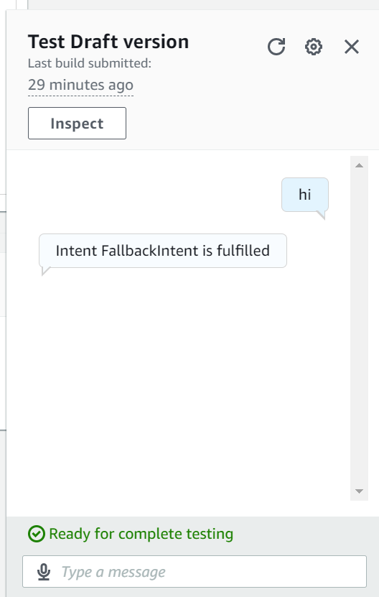
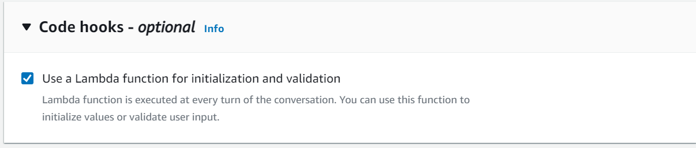
Challenges within the Diamond Price Predictor Bot

